Slide 1
Tutorial 5

Slide 2
Topics
High pass and Low pass Filter circuits
Integrator and Differentiator circuits

Slide 3
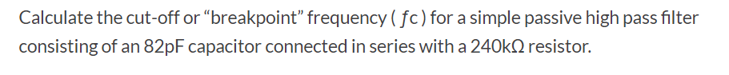
(1)

Slide 4
(2) For the 1st order butter worth HPF calculate the value of R if C=0.0047uF and fc=10kHz

Slide 5
(3) Design a HPF circuit for 10 kHz cut-off frequency

Slide 6
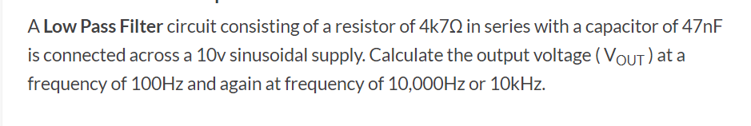
(4)

Slide 7
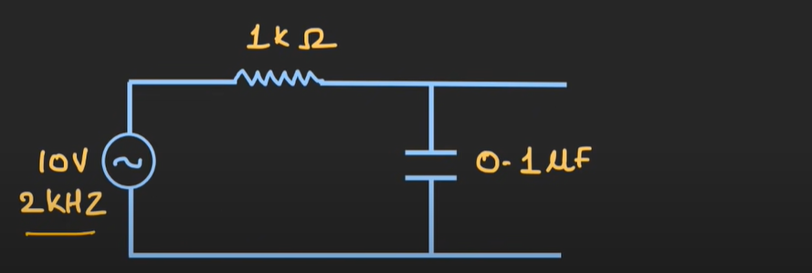
(5) For the given LPF find the -3dB frequency & output voltage at 2 kHz. Also plot the frequency response characteristics for the given LPF

Slide 8
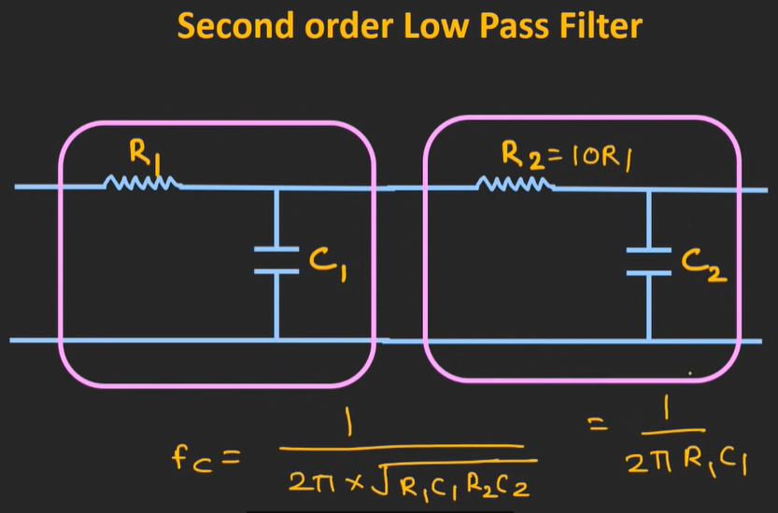
(6)

Slide 9
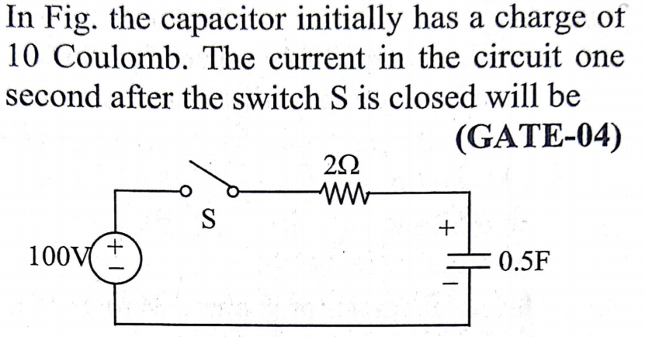
(7)

